Slide 1


Data@ANZ Virtual Internship Program
Ravindi Nanayakkara
PhD Candidate/Researcher
La Trobe University, Australia
D.Nanayakkara@latrobe.edu.au

Slide 2
Task 2:
Predictive Analytics

Slide 3
Important attributes of Data@ANZ data set
Total number of transactions: 12043
Total number of customers: 100
Time duration: 3 months
Attributes
Status: Posted/ Authorized
Card present flag: 0/1 and missing data present
Account No: A unique I.D.
Transaction description: Internet Bank, Pay/Salary, Payment, Phone Bank, POS, Sales-POS
Merchant I.D.: A unique I.D. and missing data present
Balance
Date
Gender
  Age
  Merchant suburb: Categorical and missing data present
  Merchant state: Categorical and missing data present
  Debit/Credit amount
  Transaction I.D.
  Customer I.D.
  Transaction type: Categorical and Credit, Debit
  long_lat: Customer location and 1 missing value

Slide 4
Analysis of Annual Salary ANZ Customers
Computing the exact annual salary for each customer was bit of a challenging task as customers had different number of transactions pertaining to “PAY/SALARY”.
The transaction count corresponding to the “PAY/SALARY” for the three month time period ranged as 2,3,4,5,6,7,12,13,14.
The transaction counts 3,6,7,12,13 and 14 seem to be normal as customers can be paid on a monthly, fortnightly, or weekly basis.
When a random customer was investigated whose transaction count was 2, it was found that the customer had been only paid for September and October.
And also when a random customer was investigated whose transaction count was 4, it was revealed that the customer had been paid the same amount twice for the month of October which should be an erroneous transaction.
And also when a random customer was investigated whose transaction count was 5, it was revealed that the customer had been paid the same amount twice for the months September and October which should be erroneous transactions.
The annual salary cannot be computed by considering 12*mean(amount) as mean(amount) is the average amount per a transaction and there are more than 12 pay transactions taking place in a financial year(For example if a customer gets paid 4 times per month = 4 PAY transactions =>(4*12) = 48 transactions.
Therefore, the approximate annual salary of a customer was calculated by multiplying the total salary the customer received for a three month time period by 4.

Slide 5
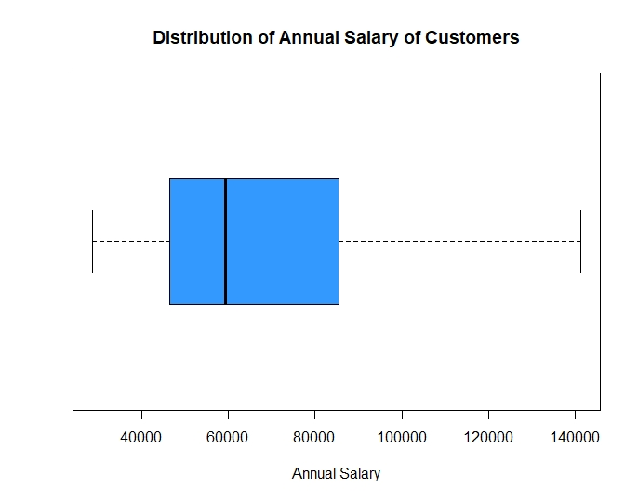

Analysis of Annual Salary ANZ Customers
Figure 1
The approximate annual salary for each ANZ customer was calculated by considering 4*total(salary for 3months). Figure 1 shows the boxplot drawn to visualize the distribution of annual salary of customers. It seems that the boxplot is positively skewed suggesting that majority of the customers have an approximate annual salary of 60,000. There are no specific outliers in the distribution of annual salary of ANZ customers. The minimum and maximum salaries were reported as 28624 and 141376 respectively. The mean and median annual salaries were found as 67063 and 59254 respectively.

Slide 6
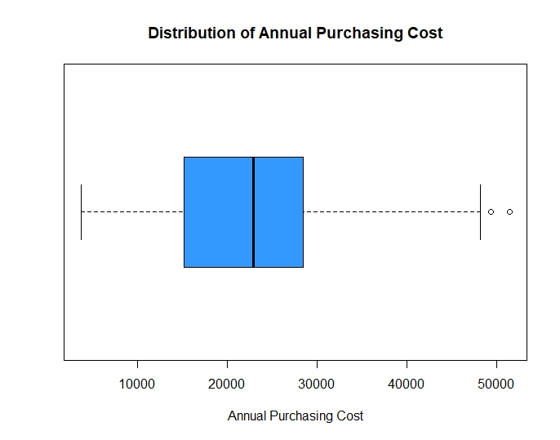

Analysis of Annual Purchasing Cost of ANZ Customers
Figure 2
The approximate annual purchasing cost of each ANZ customer was calculated by considering 4*total(purchasing cost for 3months). Figure 2 depicts the boxplot drawn to visualize the distribution of annual purchasing cost of customers. It seems that the boxplot is positively skewed suggesting that majority of the customers spend an annual purchasing cost of 23000. There are two extreme values that can be observed in the distribution of annual purchasing cost of ANZ customers. The minimum and maximum annual purchasing costs were reported as 3702 and 51463 respectively. The mean and median annual purchasing costs were found as 23468 and 22899 respectively.

Slide 7
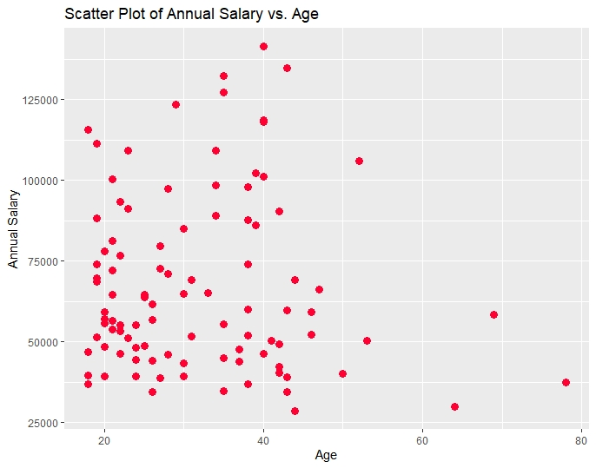
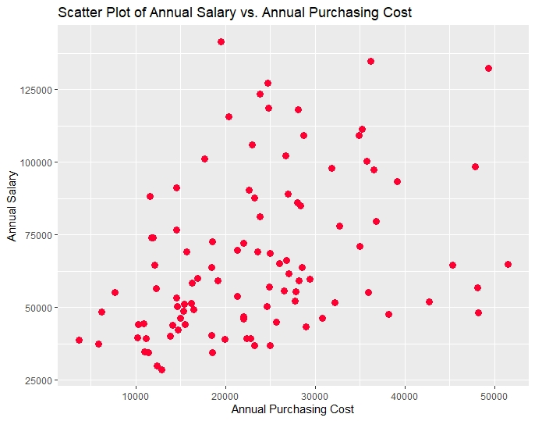
Correlation Analysis of ANZ Customers
Figure 3
Figure 4
Figures 3 and 4 show the scatter plots drawn to assess the relationships between annual salary vs. age and annual salary vs. annual purchasing cost respectively. It can be depicted from Figure 3 that there exists a very weak negative correlation(-0.0365) or no correlation at all between the two variables annual salary and age of ANZ customers. Moreover, it can be noticed from Figure 4 that there exists a weak positive correlation(0.3734) between the two variables annual salary and annual purchasing cost. Therefore, it is worthwhile to see whether the annual salary of ANZ customers can be predicted by using annual purchasing cost as the explanatory variable.

Slide 8
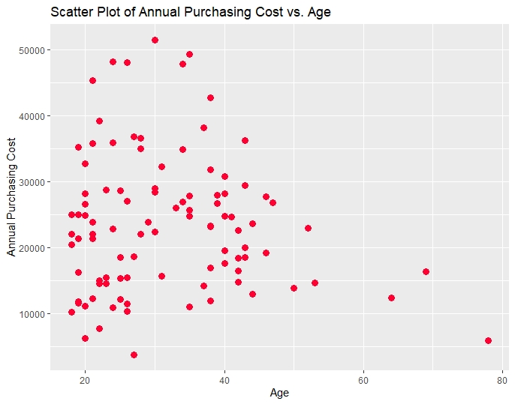
Correlation Analysis of ANZ Customers
Figure 5
Figure 5 visualizes the scatter plot which was drawn to assess the association between the two variables annual purchasing cost and age of ANZ customers because as purchasing cost might differ depending on the age. It can be highlighted from Figure 5 that there exists a very weak or no correlation at all between these two variables. The computed correlation coefficient confirms this result as the correlation coefficient between the annual purchasing cost and age of ANZ customers was found as -0.0861.

Slide 9
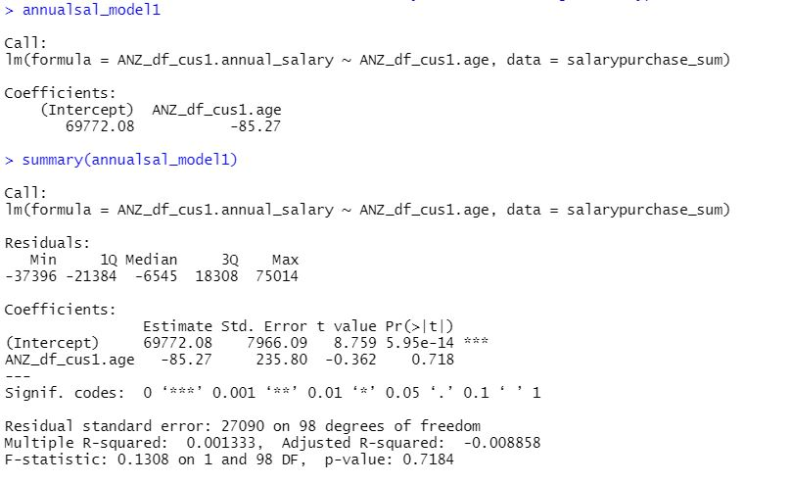
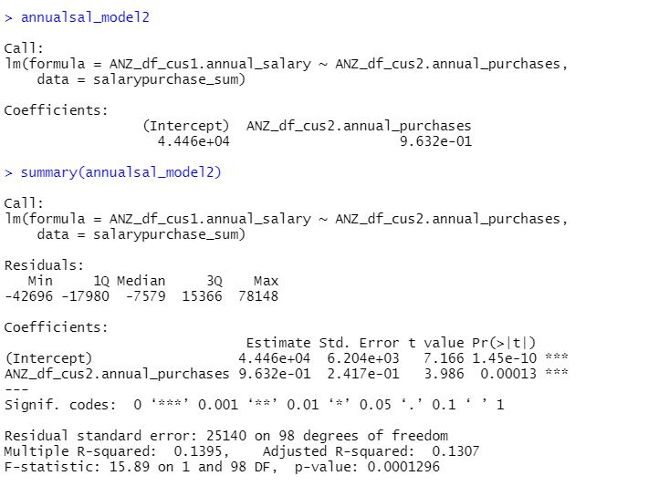
Simple Linear Regression Analysis of ANZ Customers
Two models were built to predict the annual salary of ANZ customers using the simple linear regression approach. Model 1 was built to predict the annual salary of ANZ customers using age as the independent variable. It was revealed that the age coefficient is not significant from the carried out analysis and also model 1 is not significant as the p-value(=0.7184) > 0.05. Therefore, the annual salary of ANZ customers cannot be predicted using age. Next model 2 was built using annual purchasing cost as the independent variable. Model 2 was significant as the p-value(0.00012) < 0.05 and also the intercept and the coefficient of annual purchasing cost were significant as well. R^2 of model 2 is 0.1307.
Therefore, model 2 => annual_salary = (0.9632* annual_purchasing_cost) + 0.0004446

Slide 10
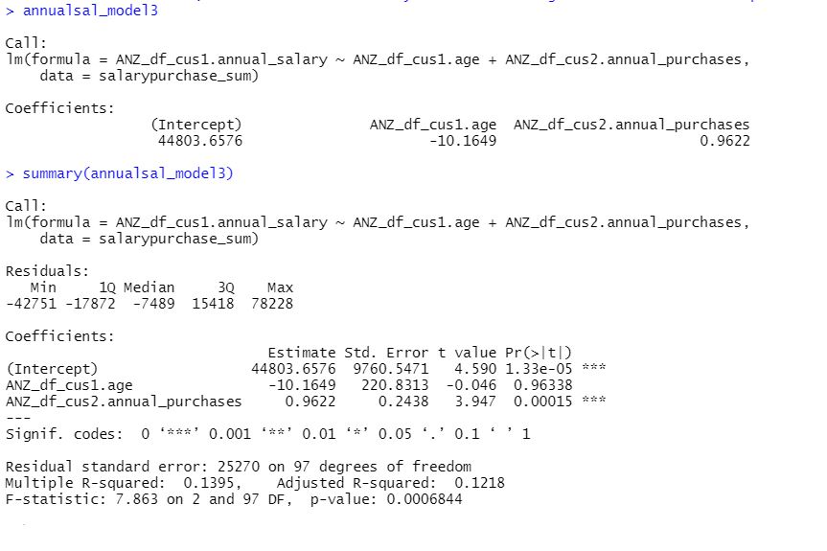
Multiple Linear Regression Analysis of ANZ Customers
Model 3 was built to predict the annual salary of ANZ customers using the multiple linear regression approach. Here, age and annual purchasing cost of ANZ customers were used as the independent variables. The carried out analysis suggested that the age coefficient is not significant as the p-value>0.05. The coefficients of the annual purchasing cost and the intercept term were significant as the p-values were less than 0.05. The model 3 was significant(p-value = 0.000684< 0.05) and the R^2 of the model was 0.1218.

Slide 11
Comparison of Models’ Performance
Model 1: Simple Linear Regression
Model 2: Simple Linear Regression
Model 3: Multiple Linear Regression
The root mean square error(RMSE) for models 1, 2 and 3 was computed. The RMSE was smallest for model 3. However in model 3, the age coefficient was not significant. Therefore, after removing the age variable, the model 3 takes the form of model 2 again.
Therefore, the best model to predict the annual salary of ANZ customers is model 2.
The best model to predict annual salary out of the built models => Model 2
annual_salary = (0.9632* annual_purchasing_cost) + 0.0004446

Slide 12
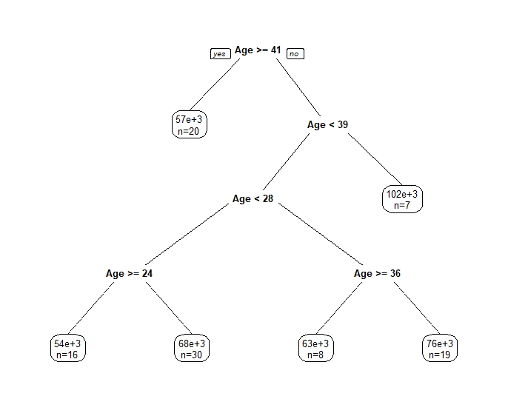
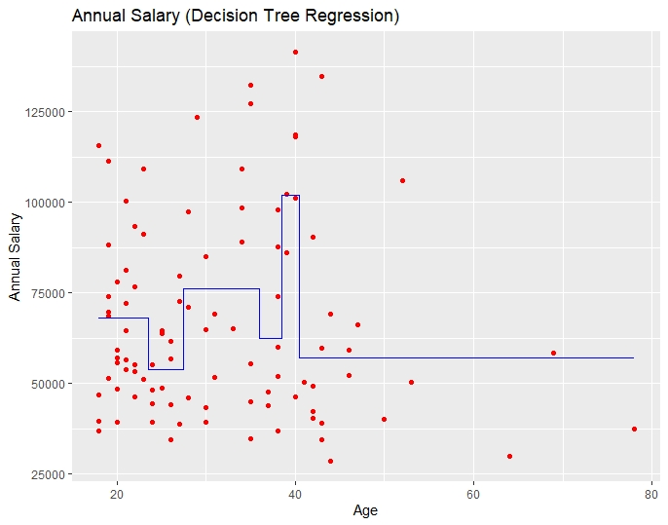
Decision Tree Regression Analysis of ANZ Customers
Decision Tree 1: Using one independent variable, “Age”
Figure 6
Figure 7
Decision tree 1 was built to predict the annual salary of ANZ customers using age as the independent variable. Figures 6 and 7 show the visualization of decision tree 1 results and the built decision tree 1 respectively.

Slide 13
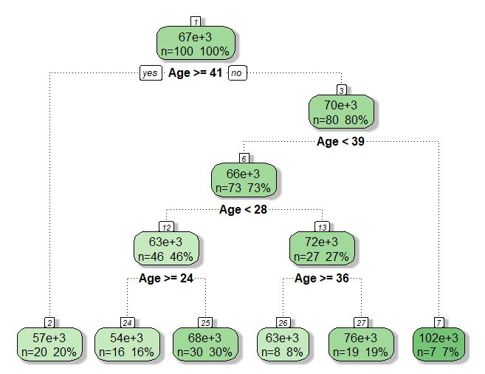

Decision Tree Regression Analysis of ANZ Customers
Decision Tree 1: Using one independent variable, “Age”
Figure 8 shows a nicer format of the built decision tree 1. According to the decision tree 1, prediction of annual salary occurs at 5 stages. That is, by partitioning the age variable using the boundary values 41, 39, 28, 24 and 36 respectively. It is clear that the lowest annual salary will be obtained by youth who are less than 24 years and the highest by the customers in between 39 to 41 years. The RMSE was computed for the decision tree 1 and it was revealed to be 23835.22.
Figure 8

Slide 14
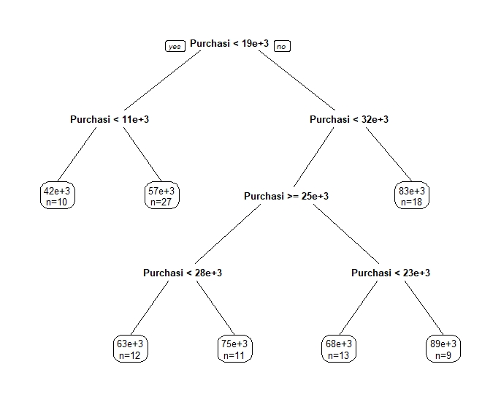
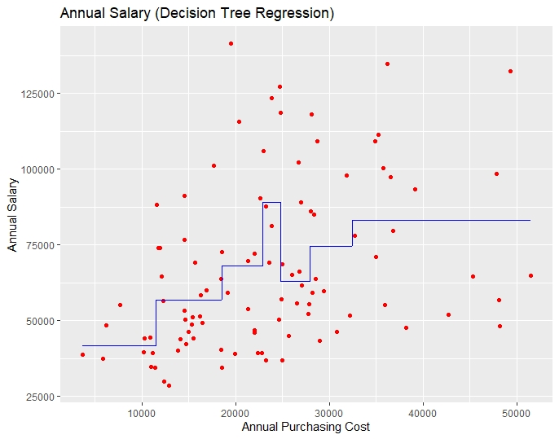
Decision Tree Regression Analysis of ANZ Customers
Decision Tree 2: Using one independent variable, “Annual Purchasing Cost”
Figure 9
Figure 10
Decision tree 2 was built to predict the annual salary of ANZ customers using the annual purchasing cost as the independent variable. Figures 9 and 10 show the visualization of decision tree 2 results and the built decision tree 2 respectively.

Slide 15
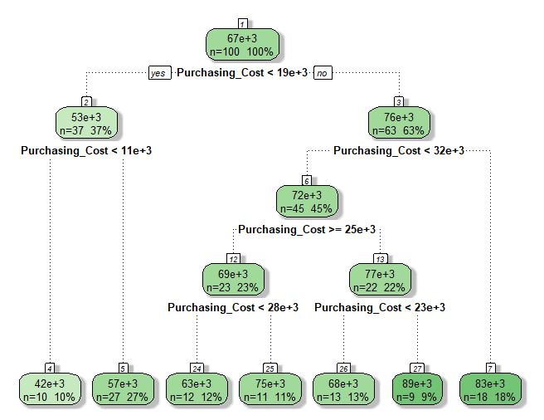

Decision Tree Regression Analysis of ANZ Customers
Decision Tree 2: Using one independent variable, “Annual Purchasing Cost”
Figure 11 shows a nicer format of the built decision tree 2. According to the decision tree 2, prediction of annual salary occurs at 6 stages. That is, by partitioning the annual purchasing cost variable using the boundary values 19000, 11000, 32000, 25000, 28000 and 23000 respectively. It is clear that the lowest annual salary will be obtained by customers whose annual purchasing cost is less than 11000 and the highest by the customers whose annual purchasing cost is in between 23000 to 25000. The RMSE was computed for the decision tree 2 and it was revealed to be 23009.09.
Figure 11

Slide 16
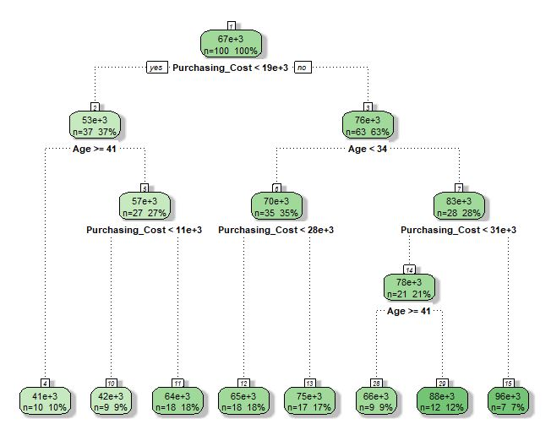

Decision Tree Regression Analysis of ANZ Customers
Decision Tree 3: Using two independent variables, “Age” and “Annual Purchasing Cost”
Decision tree 3 was built to predict the annual salary of ANZ customers using age and annual purchasing cost as the independent variables. Figure 12 shows a nicer format of the built decision tree 3. According to the decision tree 3, prediction of annual salary occurs at 7 stages. That is, by partitioning the age and annual purchasing cost variables. It is clear that the lowest annual salary will be obtained by customers whose annual purchasing cost is less than 19000 and age greater than 41 years and the highest by the customers whose age greater than 34 years and the annual purchasing cost greater than 31000. The RMSE was computed for the decision tree 3 and it was revealed to be 21764.06.
Figure 12

Slide 17

Synopsis of Predictive Analytics
The approximate annual salary of a customer was calculated by multiplying the total salary the customer received for a three month time period by 4.
The distribution of the annual salary of ANZ customers is positively skewed suggesting that majority of the customers have an approximate annual salary of 60,000.
The mean and median annual salaries were found as 67063 and 59254 respectively.
The distribution of annual purchasing cost is positively skewed suggesting that majority of the customers spend an annual purchasing cost of 23000.
The mean and median annual purchasing costs were found as 23468 and 22899 respectively.
There exists a very weak negative correlation(r=-0.0365) or no correlation at all between annual salary and age of ANZ customers.
There exists a weak positive correlation(r=0.3734) between annual salary and annual purchasing cost.
There exists a very weak(r= -0.0861) or no correlation at all between annual purchasing cost and age of ANZ customers.
The best model to predict annual salary out of the built models => Model 2
  annual_salary = (0.9632* annual_purchasing_cost) + 0.0004446
The best decision tree to predict annual salary out of the built decision trees => Decision tree 3
Decision tree 3 => using ‘Age’ and ‘Annual Purchasing Cost’ as the independent variables

